Slide 1
Econ 106: Data Analysis for Economics Lecture 9
slides adapted from: https://jhudatascience.org/tidyversecourse/model.html#descriptive-and-exploratory-analysis

Slide 2
Reminder
Research Milestone #1 is due Sunday 11:59pm
Please reach out to me if you have any questions about your choice of dataset (I’m happy to give suggestions)
You can also post your dataset here and I will give feedback
https://pollev.com/vsovero

Slide 3
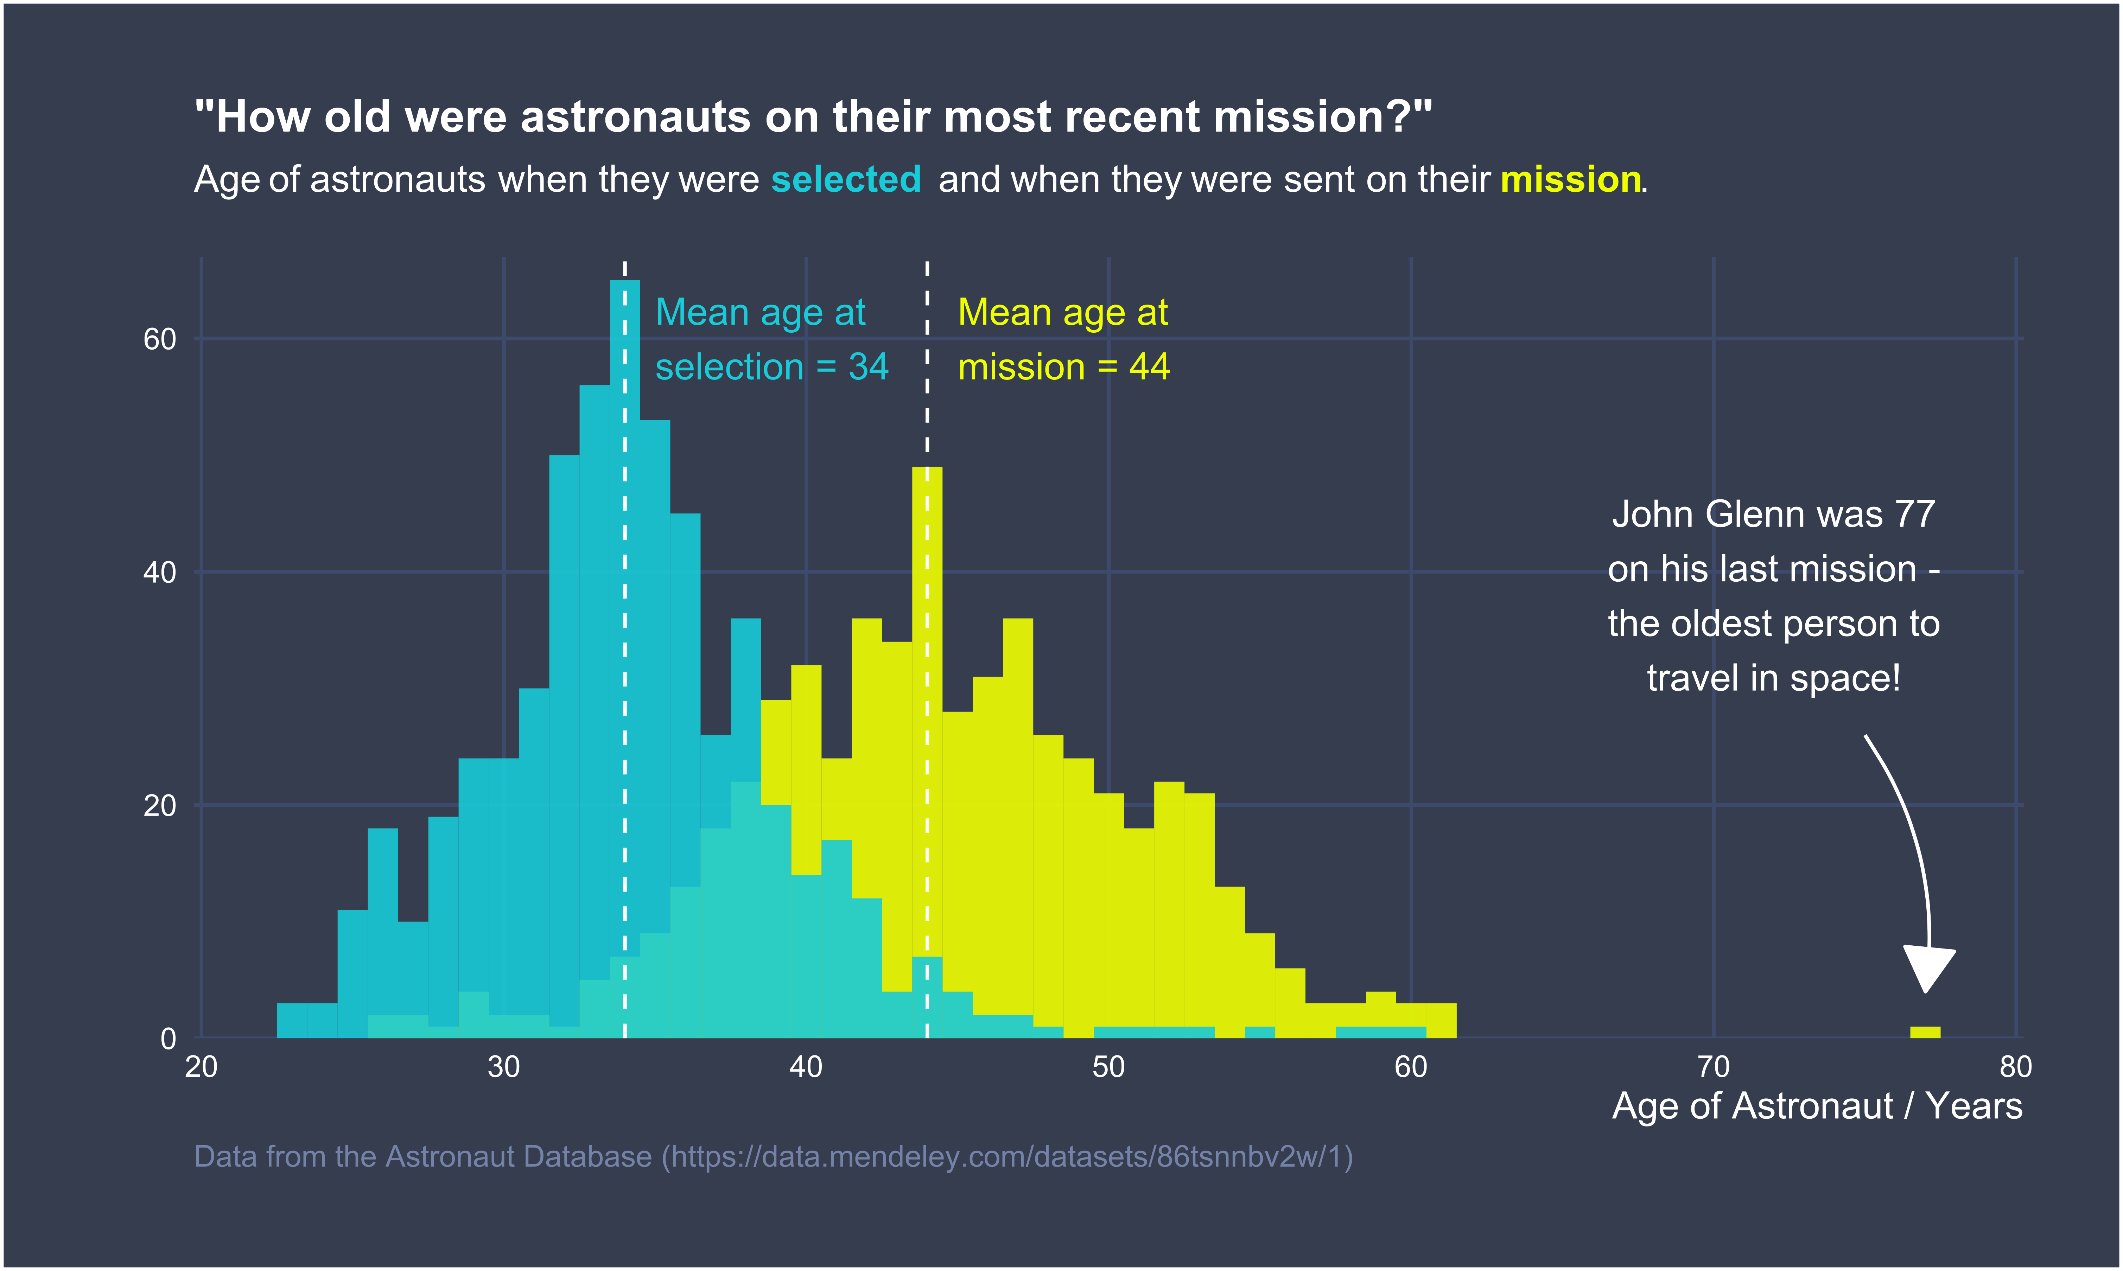
#tidytuesday
code here

Slide 4
Outline for Today
Descriptive vs. Exploratory Analysis
Summary tables and figures for:
single quantitative variable
single categorical variable

Slide 5
Descriptive vs. Exploratory Analysis
The goal of a descriptive analysis is to generate simple summaries to describe the data you’re working with
The goal of an exploratory analysis is to explore the data and find relationships that weren’t previously known.
Today: descriptive
next lecture: exploratory

Slide 6
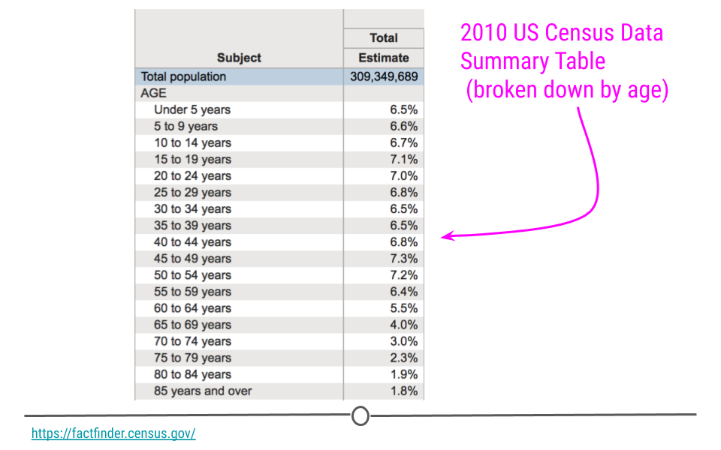
Descriptive Analysis Example: Single Variable
In the US census, the government collects a series of measurements on all the country’s residents.
This table describes the age distribution of the population

Slide 7
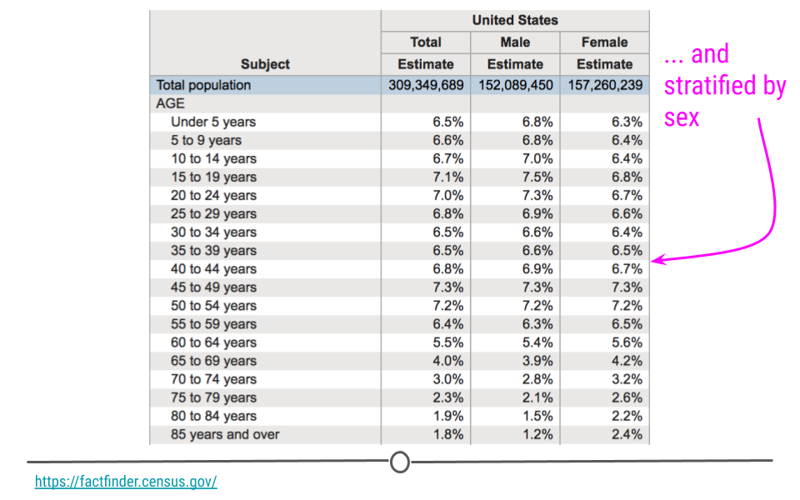
Exploratory Analysis Example: Two Variables
We can explore whether there is a relationship between age and gender
The idea: does the age distribution look different for men vs women?

Slide 8
Numeric vs. Factor Variables
How we summarize/describe a variable will depend on whether it is quantitative (numeric) or categorical (factor):
Quantitative:
histograms
density plot
Categorical:
bar plot

Slide 9
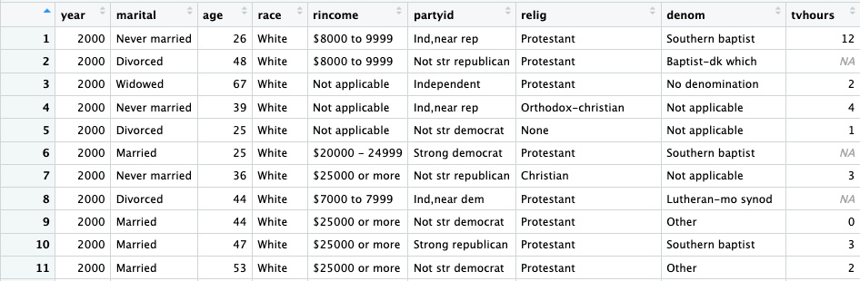
First, look at your data
Remember to always look at your data
GSS users: this is where you will see that variables you thought were quantitative are in fact categorical

Slide 10
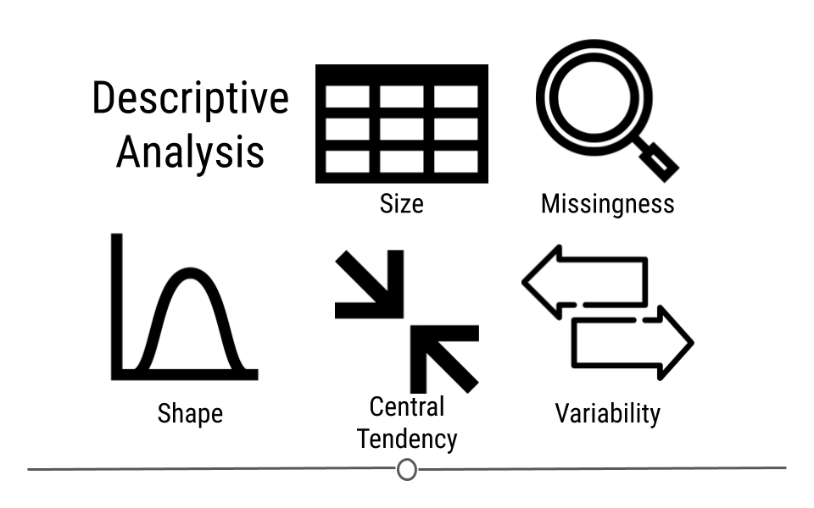
Examining Quantitative Variables
Missingness
Shape
Center
Spread
Unusual Values

Slide 11
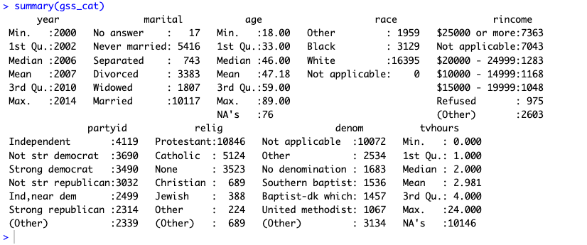
summary()
We can see some detailed information on our quantitative data (year, age, tvhours)

Slide 12
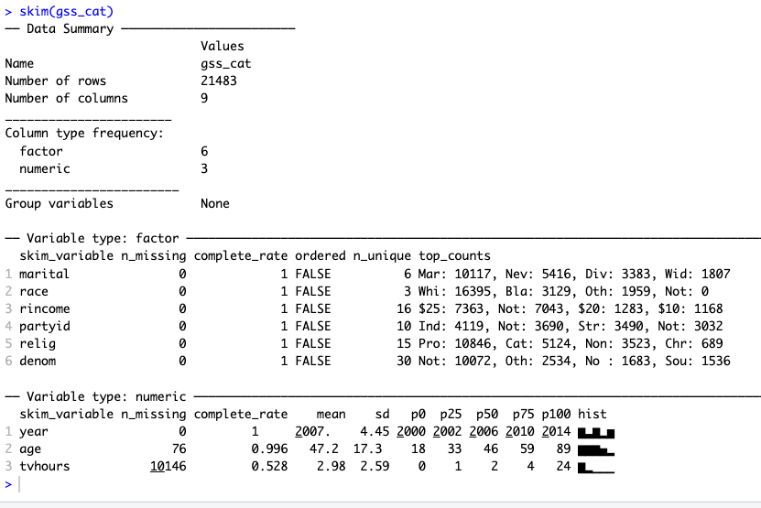
Better summaries with skimr

Slide 13
Missingness
Look for variables that have a lot of missing data:
tvhours
Why is it missing? What should we do about it?

Slide 14
Missingness
Data for a variable can be missing for a variety of reasons:
the variable was included in some survey years, not others
only a subset of people answered the question based on some characteristic
missing at random
In the first two cases, missingness is conveying information

Slide 15
Example: Commute Times
Live off campus? | commute time | distance from campus
TRUE | 75 | 105
FALSE
TRUE | 45 | 54
FALSE
TRUE | 10 | 5
TRUE | 5 | 65
TRUE | 15 | 438
TRUE | 60 | 6248
Examine the cases that have missing commute times and distance
What is your student sample if you filter out cases where commute time is missing?

Slide 16
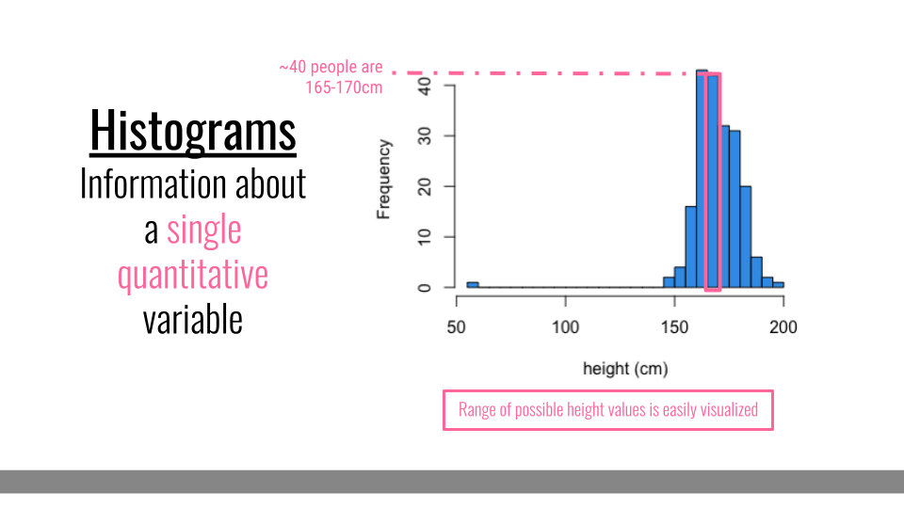
Summarizing a Quantitative Variable: Histograms
Histograms are helpful when you want to understand what values you have in your dataset for a single variable.

Slide 17
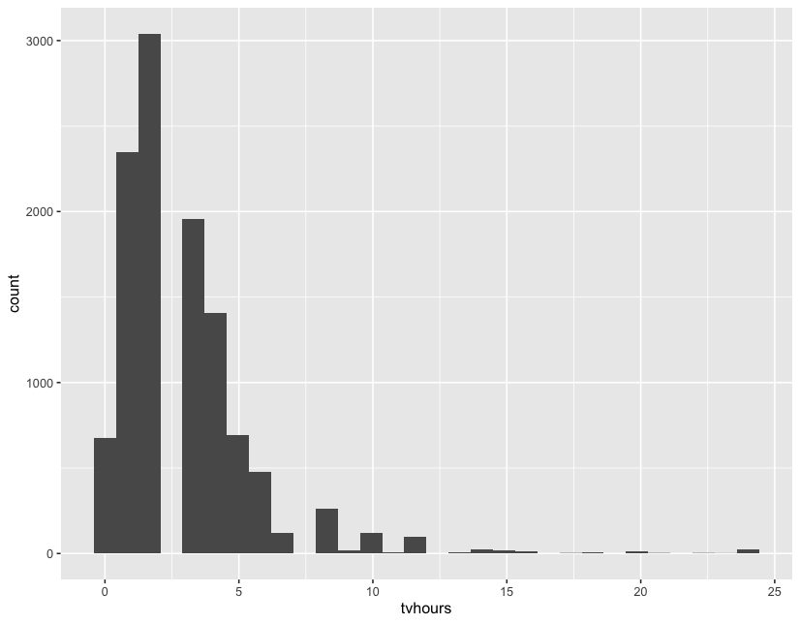
geom_histogram()
ggplot(data = gss_cat,
mapping=aes(x=tvhours)) +
geom_histogram()

Slide 18
Looks kind of funny
Weird looking distribution
Why did this happen?
tvhours are reported in increments of 1 (values range from 0-24)
ggplot default is to create 30 bins
Result:
bins start at some negative value
bins are in increments of less than 1

Slide 19
A Better Histogram
Let’s set the starting value (boundary)
Let’s also set the width of the bins (binwidth)
ggplot(data = gss_cat,
mapping=aes(x=tvhours)) +
geom_histogram(boundary=0, binwidth=1)

Slide 20
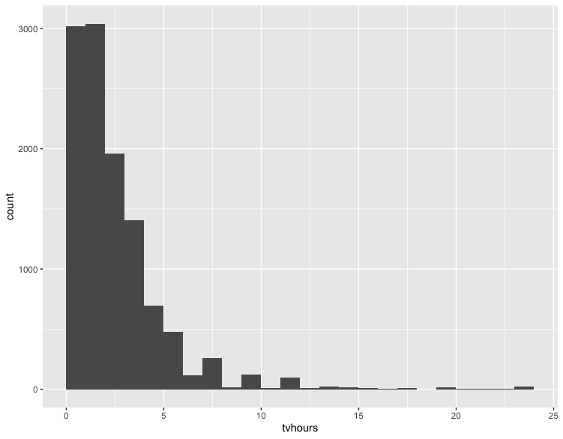
A Better Histogram
ggplot(data = gss_cat,
mapping=aes(x=tvhours)) +
geom_histogram(boundary=0, binwidth=1 )

Slide 21
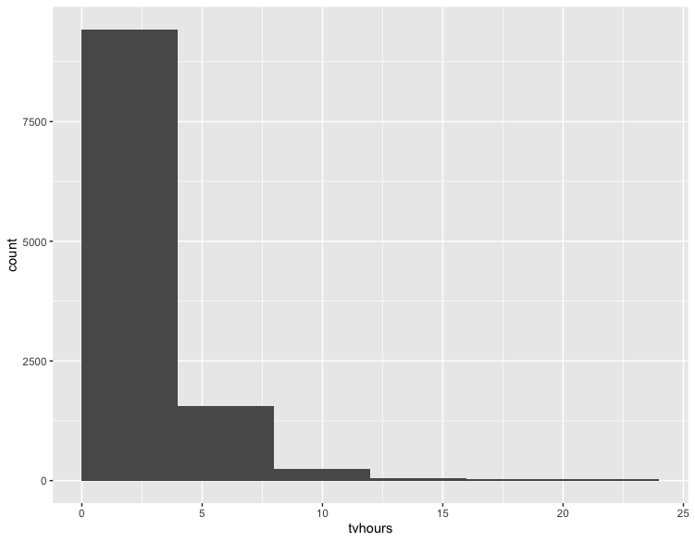
A Better Histogram (?)
ggplot(data = gss_cat,
mapping=aes(x=tvhours))+
geom_histogram(boundary=0, binwidth=4 )

Slide 22
A Better Histogram (?)
With histograms, it can be hard to decide what’s the “correct” bin width
when your bins get too narrow, it creates patterns that aren’t really there
when your bins get too wide, it erases the finer details of the distribution

Slide 23
Exercise
Make a histogram for age, then adjust the bin width as needed
https://pollev.com/vsovero

Slide 24
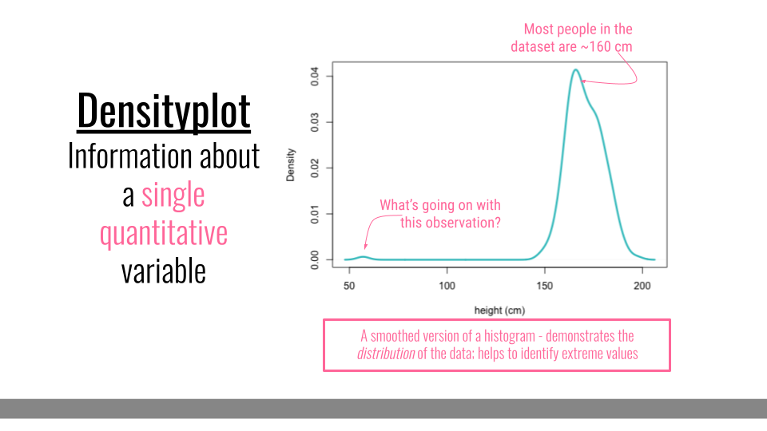
Densityplot
Densityplots are smoothed versions of histograms, visualizing the distribution of a continuous variable.
Compared to histograms, they are less sensitive to the number of bins chosen for visualization.

Slide 25
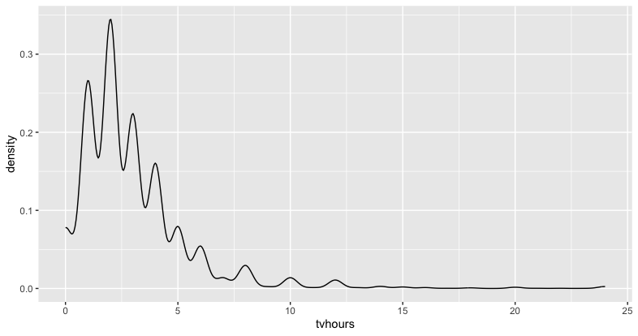
geom_density()
ggplot(data = gss_cat,
mapping=aes(x=tvhours)) +
geom_density()

Slide 26
Too Lumpy
The density plot looks “lumpy” because tvhours is an integer
the lumps are at every integer (1,2,3,etc.)

Slide 27
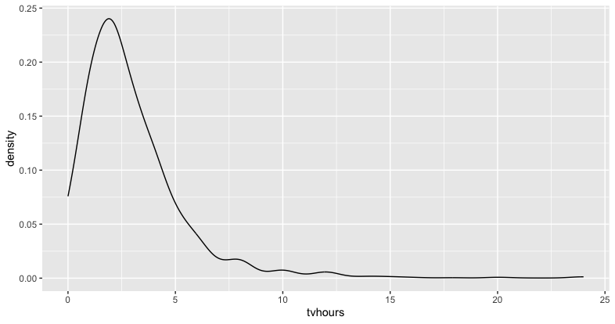
Adjusting the bandwidth
Let’s select a larger bandwidth (smooth out the bumps):
ggplot(data = gss_cat,
mapping=aes(x=tvhours)) +
geom_density(adjust=2)

Slide 28
Exercise
Make a density plot for age, then adjust the bandwidth as needed

Slide 29
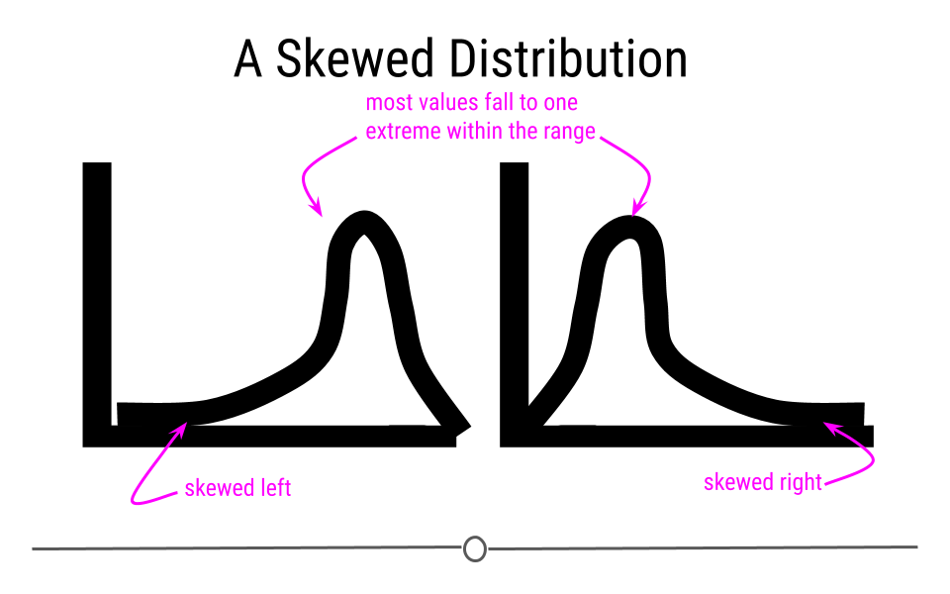
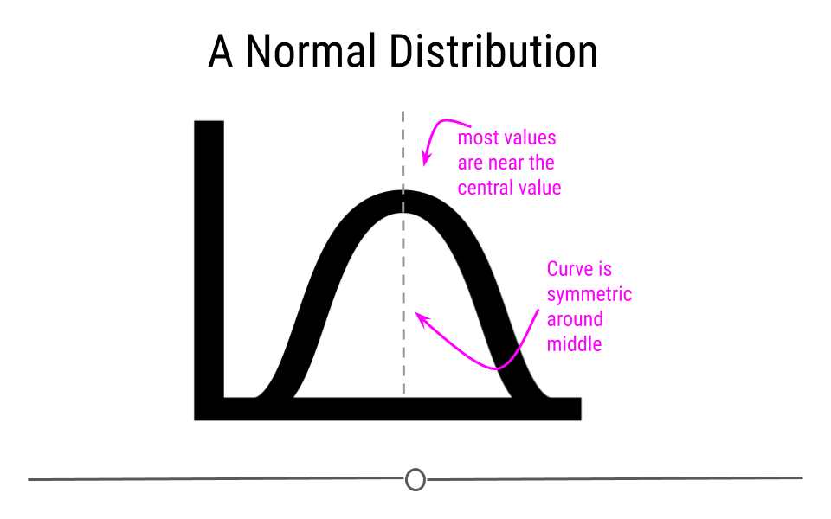
Describing the Shape of the Distribution

Slide 30
Tvhours Example
Right-skewed distribution
most people watch tv for between 0 and 5 hours per day
very few watch 10 or more

Slide 31
Tvhours Example
Right-skewed distribution
mean>median
75% of the sample watches less than 4 hours of tv per day

Slide 32
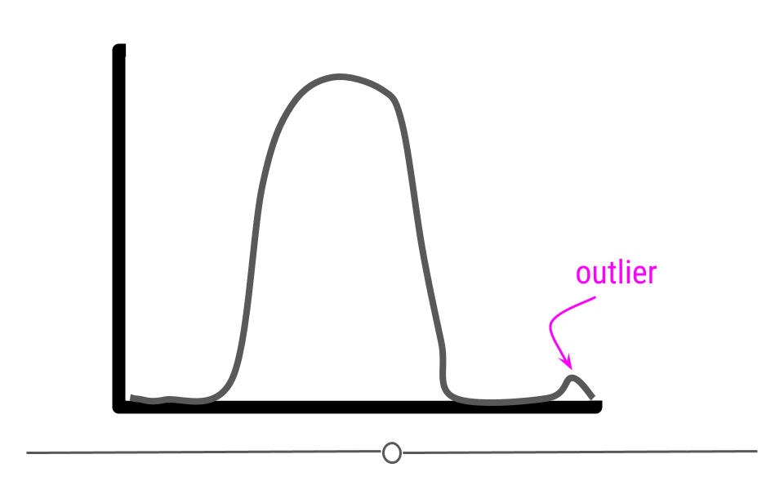
Outliers
Plotting the distribution is also helpful for identifying any unusually large or small values (outliers)
Should we get rid of them? How do we decide?

Slide 33
Extreme Values
Values that are much larger or smaller than the rest of your distribution should be investigated until you are able to classify them into one of these categories:
They are erroneous (and should be excluded).
Example: missing values coded as 9999998
a value is measured in meters when it should be in cm
They are correct and produced by the same process as less extreme values (and should be retained).

Slide 34
What do we do about outliers? Mostly nothing.
🗣I don’t know who needs to hear this but we ✨don’t✨ get rid of outliers because they’re extreme... we get rid of them when their extremeness indicates they’re not a part of the data generating process we want to study (like a typo that says your newborn is 1000 lbs)
— Chelsea Parlett-Pelleriti (@ChelseaParlett) February 1, 2021
https://pollev.com/vsovero

Slide 35
Categorical Variables: summary()
Be careful: summary() doesn’t show all the levels in a factor if you are summarizing the entire data frame

Slide 36
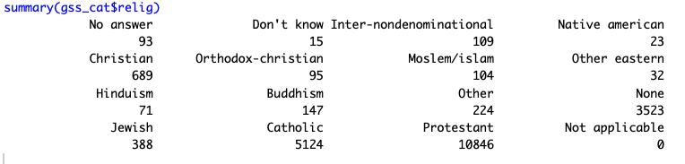
Categorical Variables: summary()
summary() will show all the levels in a factor if you summarize a single variable

Slide 37
Summaries with skimr
With skim() you won’t see all of the levels of a factor variable, but you will at least know how many levels there are

Slide 38
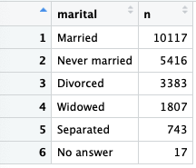
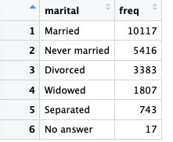
Best Option: dplyr
marital_summarize<-gss_cat%>%
group_by(marital)%>%
summarize(freq=n())%>%
arrange(desc(freq))
marital_count<-gss_cat%>%
count(marital)%>%
arrange(desc(n))

Slide 39
Exercise
Create a frequency table for relig. Sort the levels from most to least frequent

Slide 40
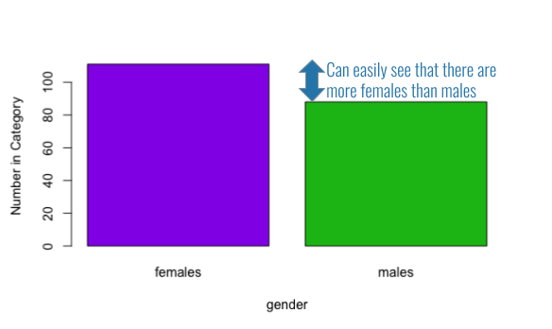
Summarizing a Categorical Variable
There are actually many options, but the most common is the bar plot

Slide 41
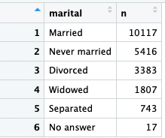
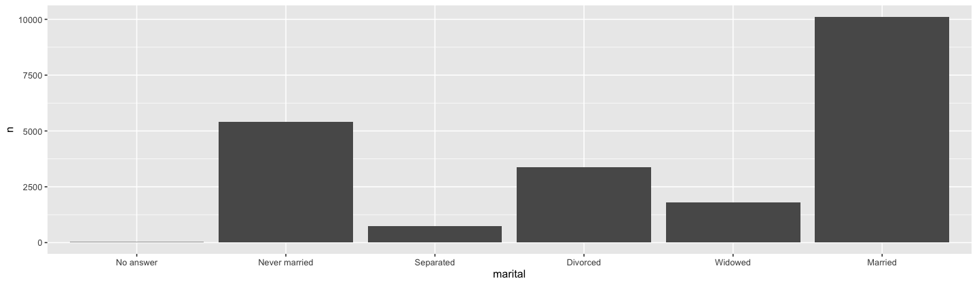
Bar plot from a Frequency Table
Bar plot: reports frequencies of each level
If you already created a frequency table (marital_count), use geom_col()
ggplot(data = marital_count,
mapping=aes(x=marital, y=n )) +
geom_col()

Slide 42
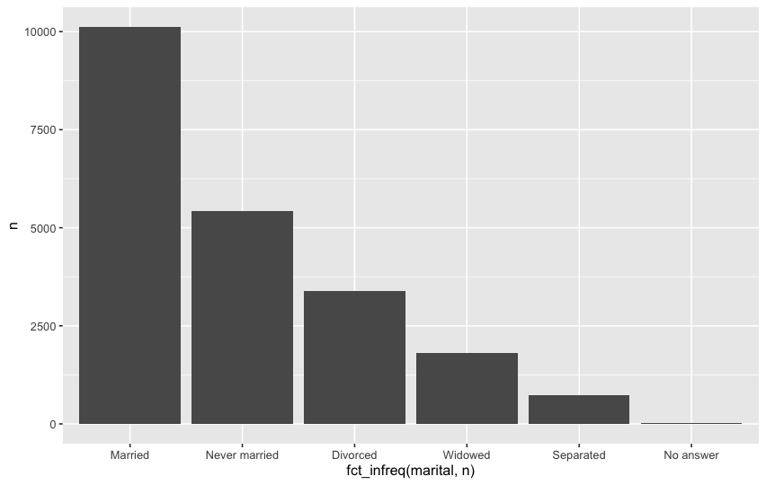
Bar plot ordered by frequency
If we want to sort the bar plot by frequency, we can use fct_infreq()
Arguments:
the name of the factor variable
The variable that counts the frequencies (only when your data is a frequency table)
ggplot(data = marital_count,
mapping=aes(x= fct_infreq(marital,n), y=n ))+
geom_col()

Slide 43
Exercise
Create a bar chart for relig using geom_col().
Display the levels by frequency.
https://pollev.com/vsovero

Slide 44
Bar plot from the original data
Bar plot: reports frequencies of each level
If you didn’t create a frequency table, use geom_bar() with the original data frame (gss_cat)
ggplot(data = gss_cat,
mapping=aes(x=marital)) +
geom_bar()

Slide 45
Bar plot ordered by frequency
If we want to sort the bar plot by frequency, we can use fct_infreq()
Arguments:
the name of the factor variable
ggplot(data = gss_cat,
mapping=aes(x= fct_infreq(marital) ))+
geom_bar()

Slide 46
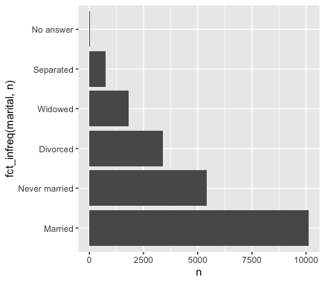
Horizontal Bar plot ordered by frequency
ggplot(data = gss_cat,
mapping=aes(x= fct_infreq(marital)))+
geom_col() +
coord_flip()
When there are a lot of levels, it looks better to flip the direction of your bar plot
we can use coord_flip()
note that we add this to our ggplot using the + operator

Slide 47
Exercise
#Create a bar chart for relig using geom_bar().
Display the levels by frequency.
Rotate the bars so they're horizontal.

